Slide 1

TEAM MAJESTY

Slide 2

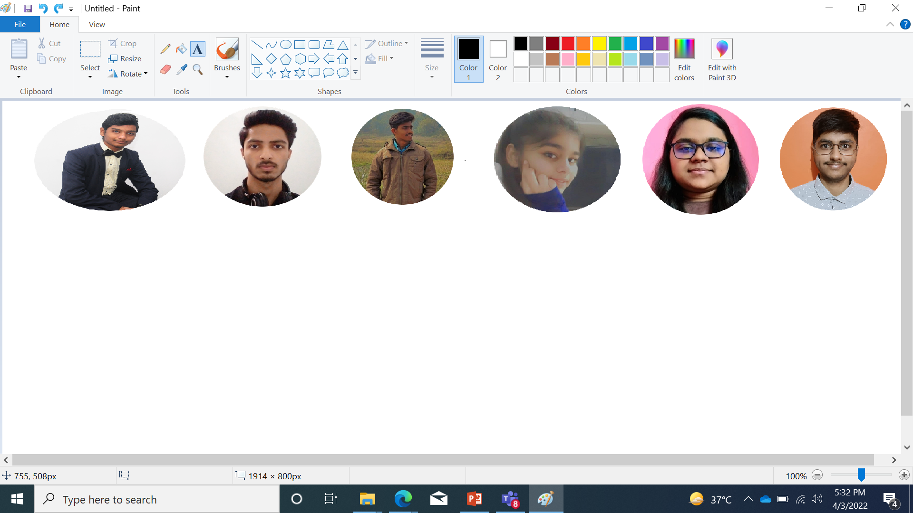
TEAM MAJESTY
Our team consists of six members who have worked really very hard to make this project successful.
Every member plays a significant role in the completion of this project. The member of the group are : K ABHIRAM, TUSHAR PRABHAKAR, ROHIT KUMAR RAY, SHRASTI ARYA, T. SAISHREE & AYUSH VERMA.

Slide 3

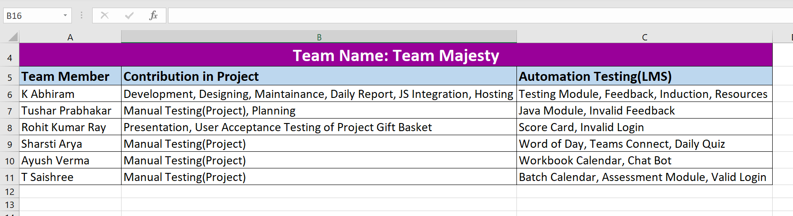

Slide 4
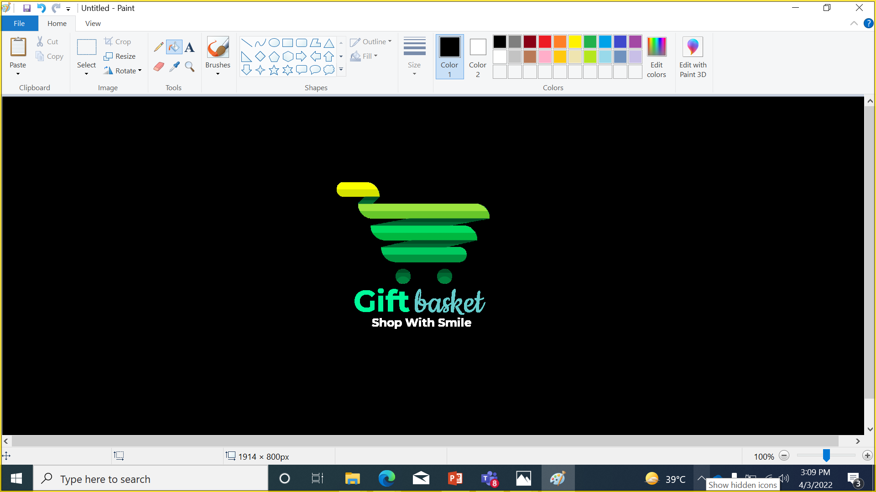
INTRODUCTION
Gift Basket is an online Digital Gift Superstore in India. At Gift basket we provide different customizable gift items for your loved ones. At Gift Basket, anyone can easily customized any Mobile phone Cases, Mugs, T-Shirts, Photo Canvas, Posters, Playing Cards, Badges, Visiting Cards and More gifting items Online within minutes.
The website is designed for the users to help them out to find items which will make them stand out in the crowd with Personalized and Unique products printed specially by them. The Website is very user-friendly and the flow of ordering items is very easy to use. It is an idea derived from the product selling concept of our very own team member K ABHIRAM online store of selling customizable items . We planned to make the items reach at the national level. So, here we (TEAM MAJESTY) present to you our website … GIFT BASKET….
Link for the website : https://abhiramprints.github.io/gift_basket/

Slide 5
HOMEPAGE
NAVIGATION BAR
ABOUT
CATEGORIES
FEEDBACK
CONTACT US
CATEGORIES AVAILABLE
MDF GIFTS
STATIONARY GIFTS
CUSTOMIZED WEARABLES
CUBICLE ESSENTIALS
GET IN TOUCH FORM
ENTER NAME, EMAIL AND MESSAGE
SEND MESSAGE
FIND US HERE
ONLINE STORE ADDRESS
FOOTER
QUICK LINKS
CONTACT DETAILS

Slide 6
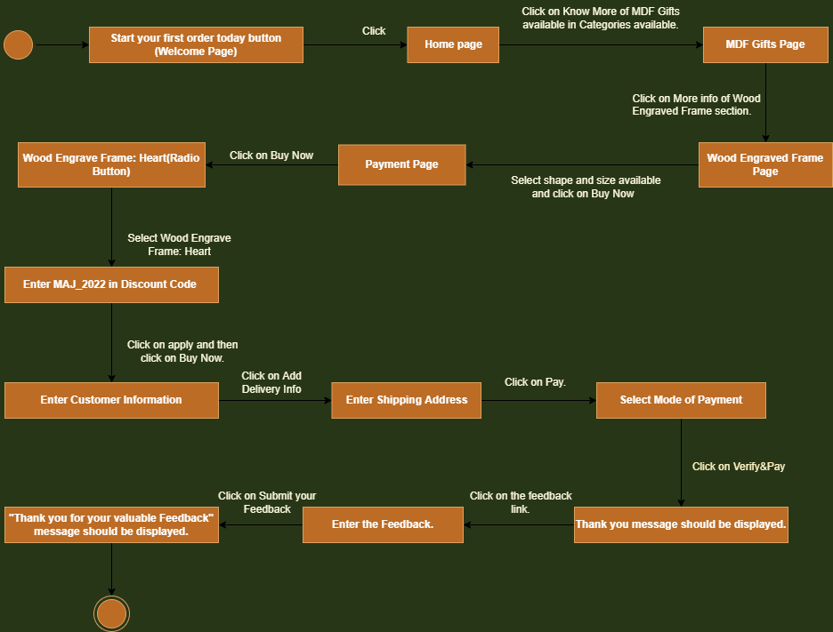

Slide 7
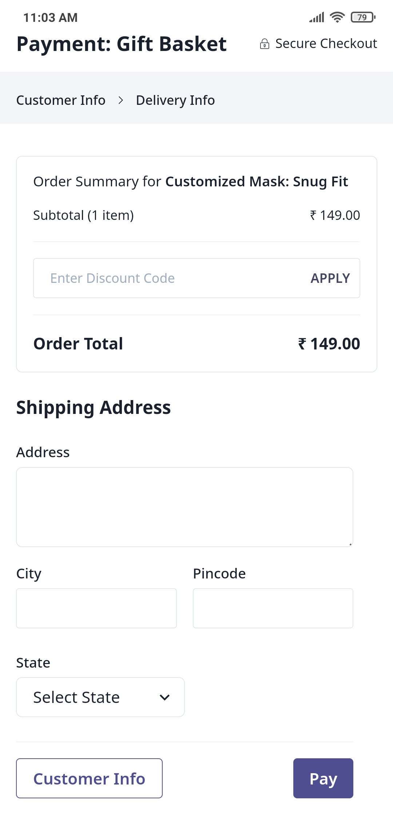
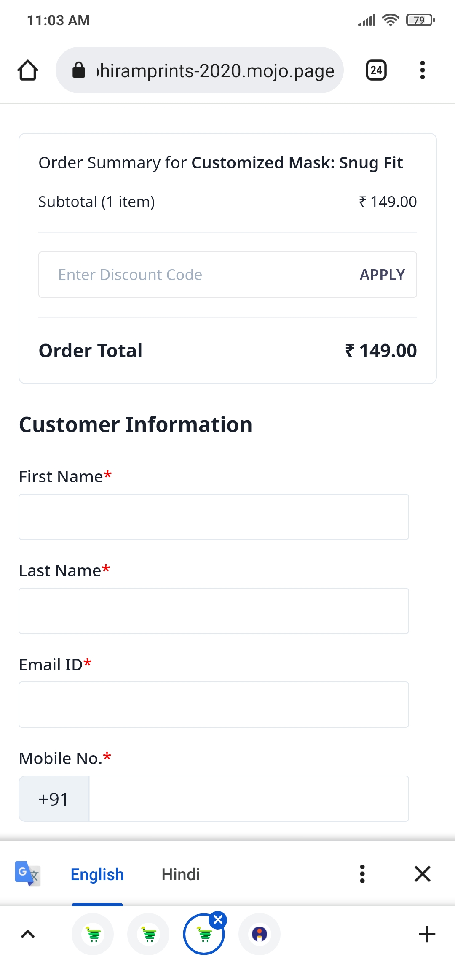
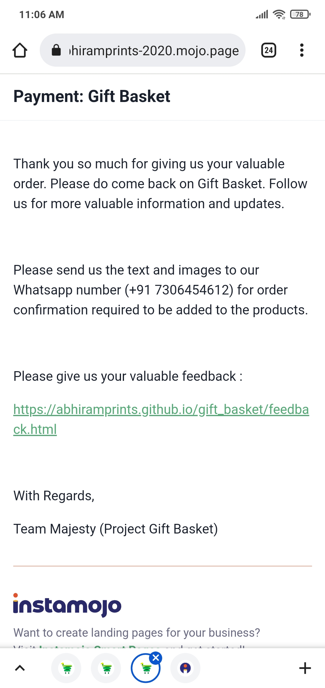
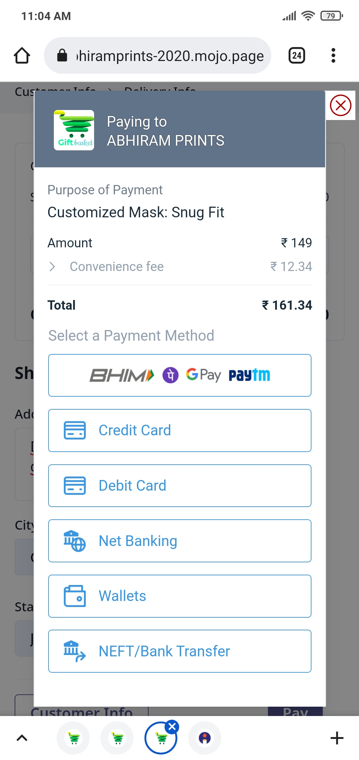
Way to complete the Transaction and order the product from Gift Basket

Slide 8

TESTING
Done BY TEAM MAJESTY

Slide 9

REQUIREMENTS SPECIFICATIONS
RO1
FUNCTIONAL DESCRIPTION
RO2
WELCOME PAGE
RO3
HOMEPAGE
RO4
PRODUCT CATALOG PAGE
RO5
PRODUCT DETAILS
RO6
TRANSACTION PAGE
RO7
FEEDBACK

Slide 10

MANUAL TESTING OF GIFT BASKET
SDLC MODEL FOLLOWED: V-SHAPED MODEL
LEVELS OF TESTING
UNIT TESTING
INTEGRATION TESTING
SYSTEM TESTING
SYSTEM INTEGRATION TESTING
USER ACCEPTANCE TESTING
TYPES OF TESTING
BLACK BOX TESTING
FUNCTIONAL TESTING
TEST CASE DESIGN TECHNIQUES
EQUIVALENCE CLASS PARTITIONING
BOUNDARY VALUE ANALYSIS
STATE TRANSITION TECHNIQUE

Slide 11

AUTOMATION TESTING
Cross Browser Testing
Checkpoints
isDisplayed()
isEnabled()
assertEquals()
Proper Error Message
Modularity
Browsers Used
How we generated XML files

Slide 12
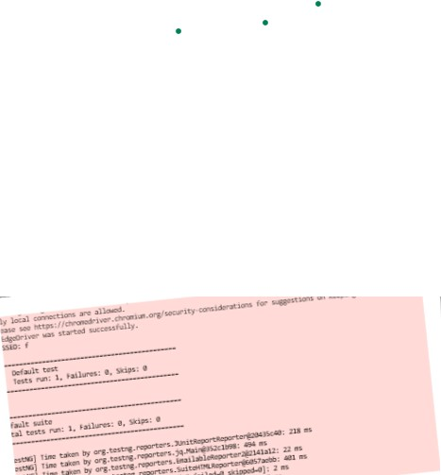
MODULES TESTED IN LMS
Java Module
Testing Module
Daily Quiz
Assessment
Batch Calendar
Scorecard
7. Chatbot
8. Resources
9. Induction
10.Workbook Calendar
11.Valid Login
12.Word Of Day
13.Teams Connect
14.Invalid Login
15.Feedback
16.Invalid Feedback

Slide 13
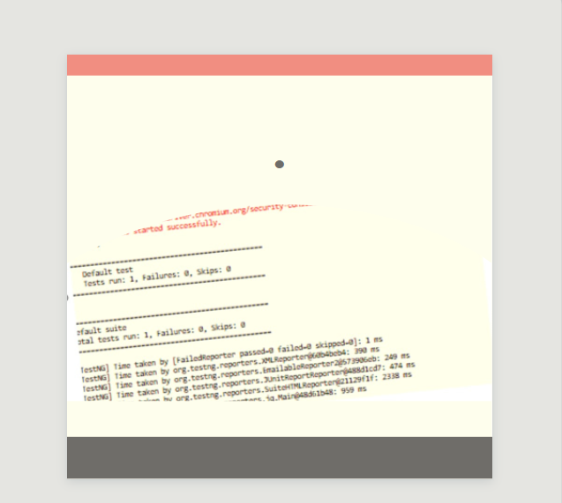
Methods Implemented
SendKeys;
Click();
Drop down();
Thred.sleep();
TestNG
Methods Implemented
sendKeys()
Click()
Drop down()
TestNG
assertEquals()

Slide 14
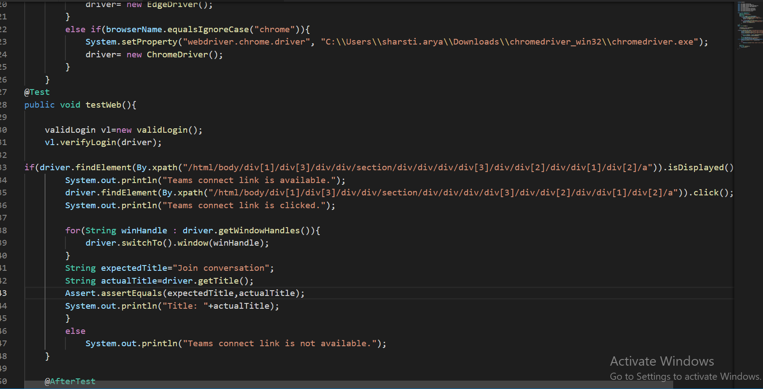

Slide 15


